Slide 1
State of the Union
Oct 2010 – Oct 2011
Nick Airdo
Developer
Central Christian Church
Email: nick.airdo@cccev.com
Twitter: @airdo

Slide 2
Where Were We?
Some modules on Arena Community Server
60 shared modules
94 shared reports
A few on Redmine
A cumbersome module market/store
IRC channel with decent participation

Slide 3

Where Are We Now?
Community Server
80 shared modules
108 shared reports
Redmine.RefreshCache.com
32+ projects (modules)
More activity!
http://redmine.refreshcache.com/activity

Slide 4
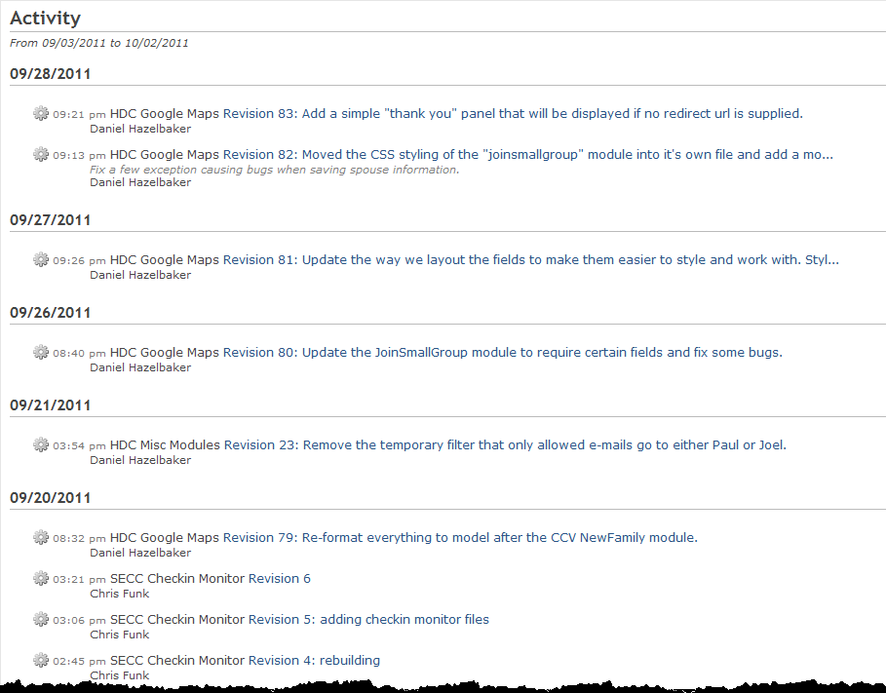

Slide 5
Where Are We?
Open source s/w / project mgmt tool (Redmine)
3-4 possible module packaging formats:
Voracity Solutions Installer
HDC Packaging System & Arena Module XML
NuGet

Slide 6
Where Are We?
Still struggling with module sharing
Still struggling with documenting your modules
Still no manageable marketplace/store

Slide 7
Where Are We?
Greater participation in IRC #ArenaChMS channel
RefreshCache conference ~ 25 -> 36

Slide 8

















Better Participation

Slide 9
Three ChMS
It’s not just for Arena anymore!

Slide 10


Open Source ChMS Options
http://bvcms.codeplex.com/
http://github.com/SparkDevNetwork/Rock-ChMS

Slide 11
Quote
“The idea of open source is all about community. Doesn’t the church represent what community should be all about? Who better than the church to embrace open source?”

Slide 12
Where Are We Going?
To some degree, I think the lack of a good “module marketplace” is contributing to slower momentum
Perhaps the new module packaging systems will help
Open Discussion?

Slide 13
Where Are We Going?
RC 2010
A few of us are looking at some open source CMS as a possible future ChMS foundation
If we go down that path we would initially begin spending our personal time working on the initiative
And later, possibly our normal work hours (pending approval of leadership, etc.)

Slide 14
Where Are We Going?
No longer relying on “… to see an ‘Arena Core CMS’ as real open source option”
Different answers for each church, but I will use RockChMS for other external websites:
“Opens the platform to other non-profits such as OneMission, OurHome Nepal, TOAG, etc.”
* These quotes are from last year’s RefreshCache

Slide 15
Future RC Invites
What other ChMS communities should we invite to RC?
Criteria
Must be active
Must be awesome (or at least not mediocre)
I prefer free or open source solutions, but am open minded.
Possibilities:
OneBody (Ruby on Rails)
Sheepology (Django, DOA?)
Fellowship One

Slide 16
Where are others going?
Thou shall not judge…

Slide 17
DotNetNuke v6
Released 8/29/2011
501,016 downloads

Slide 18
Umbraco CMS v4.7
Released 9/26/2011
311,226 downloads

Slide 19
Orchard CMS v0.1 - 1.2

Slide 20
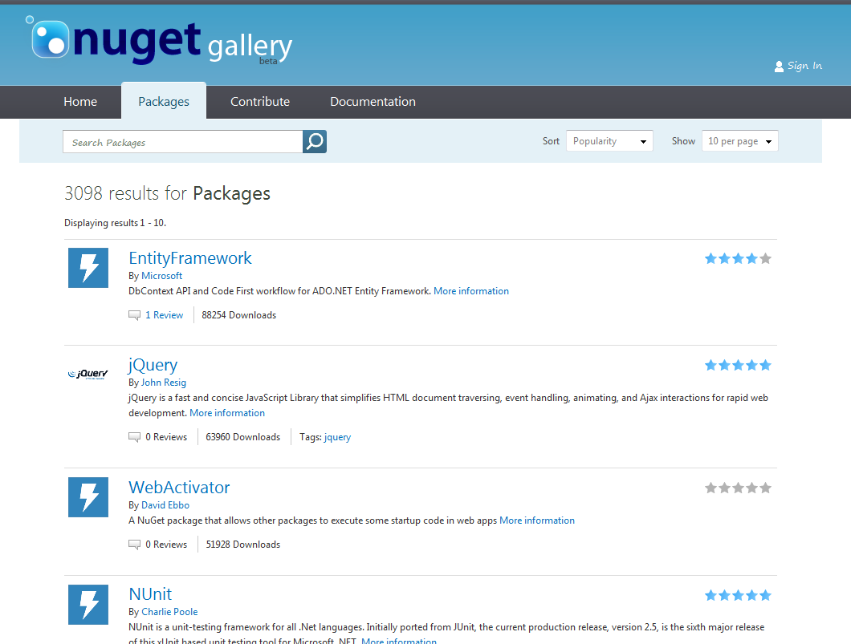
NuGet Gallery

Slide 21
But…
The RefreshCache group will continue to use/support all three ChMS systems.
Notes:
The less important parts are still pretty important if you’re driving your website
I’m tired of using DNN and Wordpress as my open source *web application framework*
PHP is OK, but I really love .NET

Slide 22
Where Are We Going?
Wherever you decide we’re going?
fin
Notes:
Doug Drinka, CCV, ShadeTree, SoChurch?

